Slide 1
DATA PIPELINE & ORCHESTRATION TOOLS
Group-5
Present By – Muskan & Ronak

Slide 2
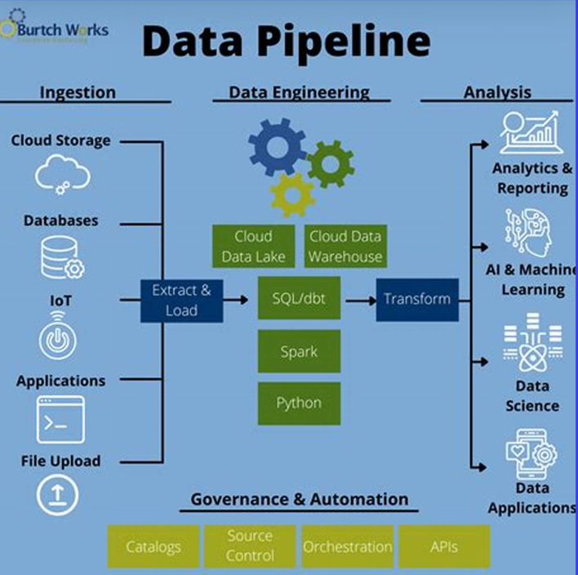
Data Pipeline Introduction
A data pipeline is a sequence of steps that move data from source to destination, ensuring it is cleaned, transformed, and stored for analysis.
Extract Load
Transform
1
2
3

Slide 3
Why Companies Need Data Pipelines
01
03
02
04
Data Volume & Velocity
Scalability
Reliability & Error Handling
Cost Optimization

Slide 4
Data Pipeline Tools & Technologies
Pipeline Type | Tools | Best Use Case | Real-World Example
Batch Processing | Apache Spark, AWS Glue, Airflow | Historical analytics, ETL workflows | Netflix uses batch Spark jobs to analyze user watch history overnight
Streaming (Real-Time) | Apache Kafka, Flink, AWS Kinesis | Fraud detection, live recommendations | Uber processes real-time ride requests & traffic data using Kafka + Flink
Hybrid Processing | Spark Structured Streaming, Kafka Streams | Personalized user experiences | Amazon combines batch ETL for inventory and real-time streaming for order tracking
🔹

Slide 5
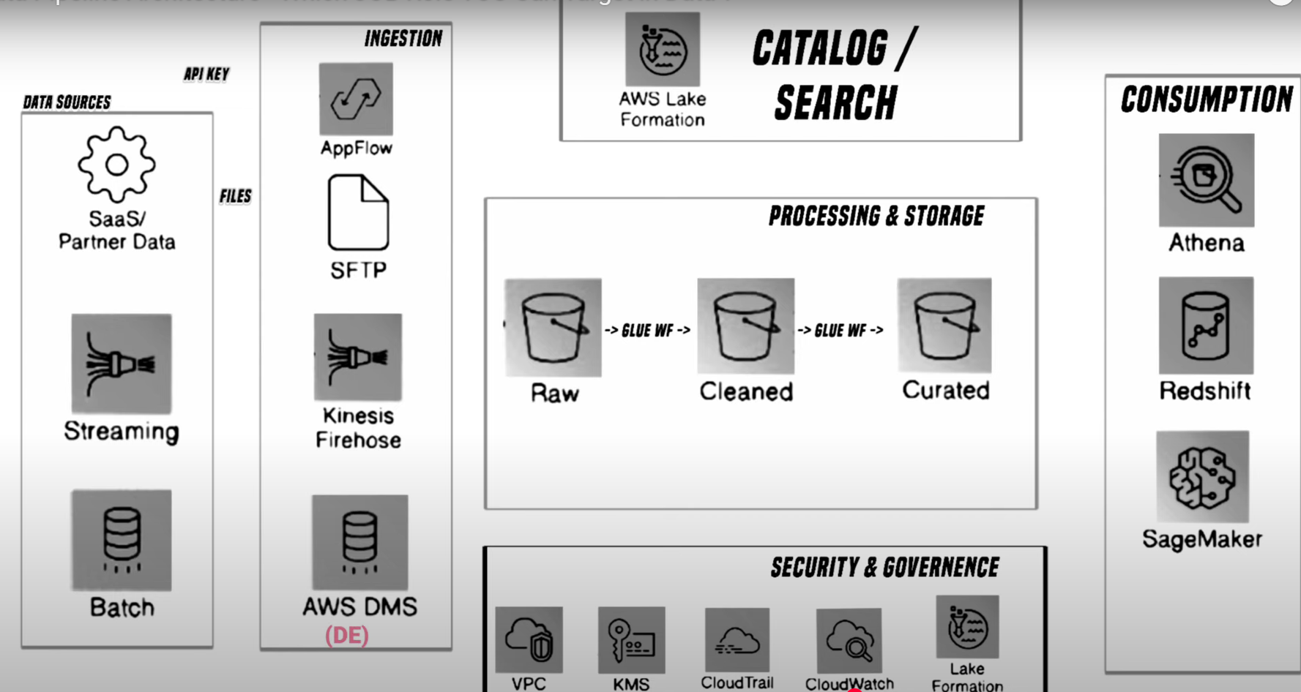
AWS Data Pipeline Architecture

Slide 6
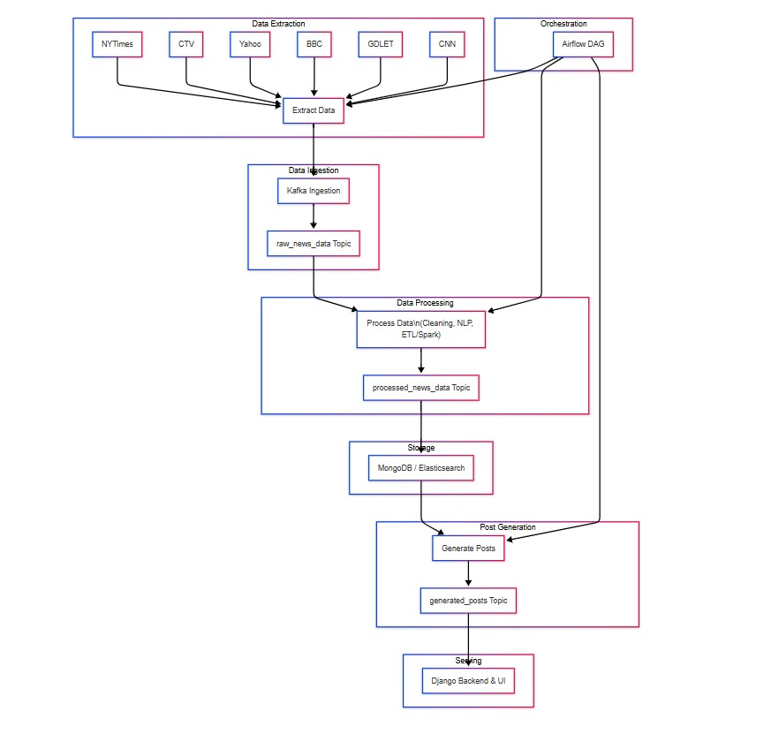
Apache Kafka

Slide 7
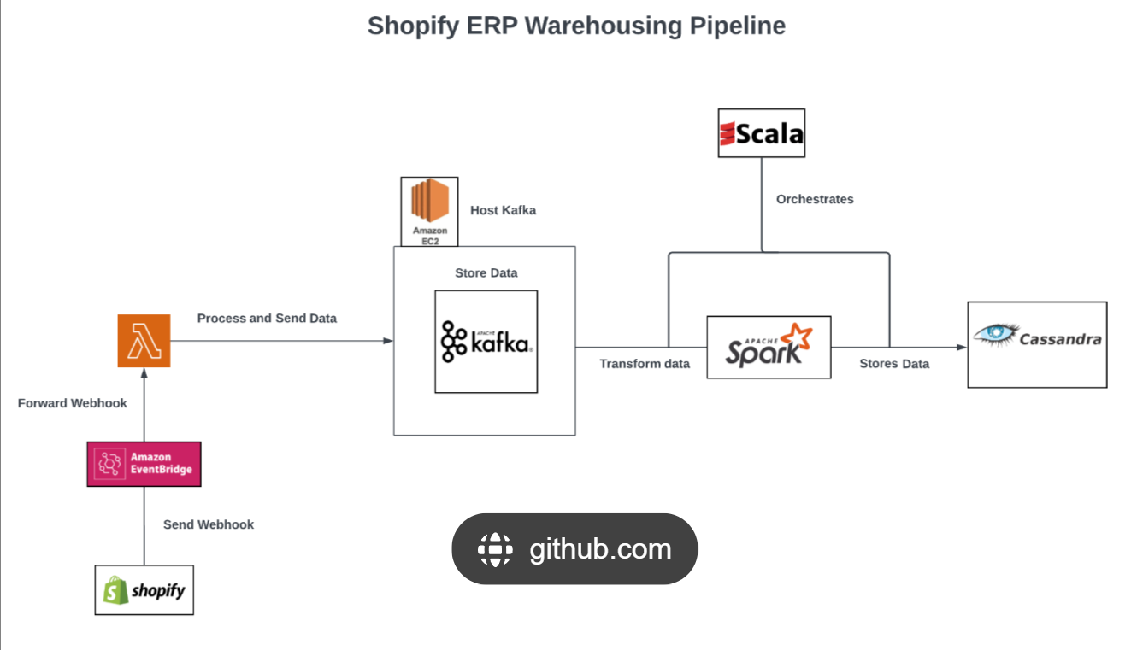
Apache Spark

Slide 8
Orchestration Introduction
Orchestration is the automated coordination, scheduling, and management of tasks, workflows, and data pipelines across multiple systems.
🔹 Why is Orchestration Important?
✅ Automation ✅ Scalability ✅ Dependency Management ✅ Error Handling & Recovery
🔹 Types of Orchestration
1️⃣ Workflow Orchestration – Automates ETL, ML workflows (e.g., Airflow, Prefect).
2️⃣ Container Orchestration – Manages Dockerized apps (e.g., Kubernetes).
3️⃣ Cloud Orchestration – Automates cloud services (e.g., AWS Step Functions).
4️⃣ Data Orchestration – Manages large-scale data movement (e.g., Dagster).

Slide 9
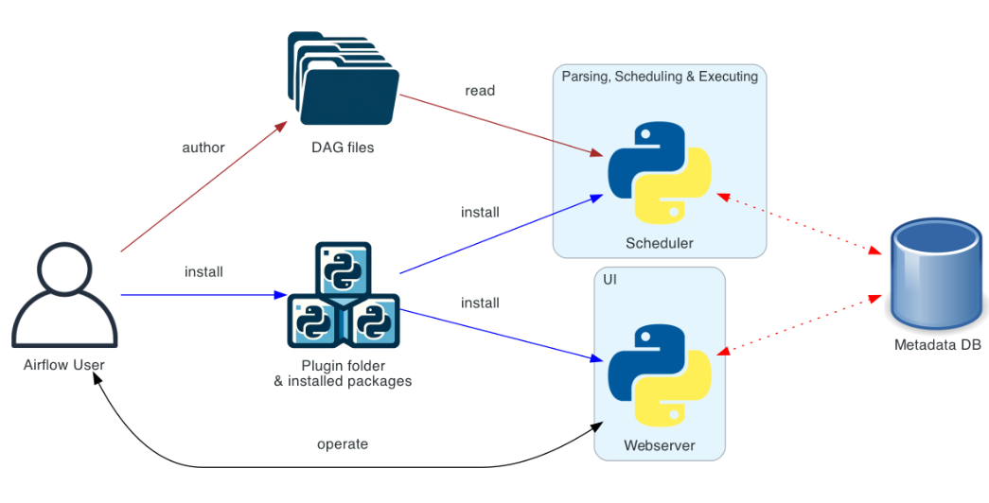
Apache Airflow
🔹 What is it? An open-source workflow orchestration tool that automates ETL, data pipelines, ML workflows, and cloud automation using Directed Acyclic Graphs (DAGs).
🔹 Why Use It? ✅ Scalable & Flexible ✅ Monitoring & Logging ✅ Integration Ready
🔹 Best Use Cases ✔ ETL & Data Pipelines ✔ Machine Learning Automation ✔ Cloud Automation ✔ Big Data Processing

Slide 10
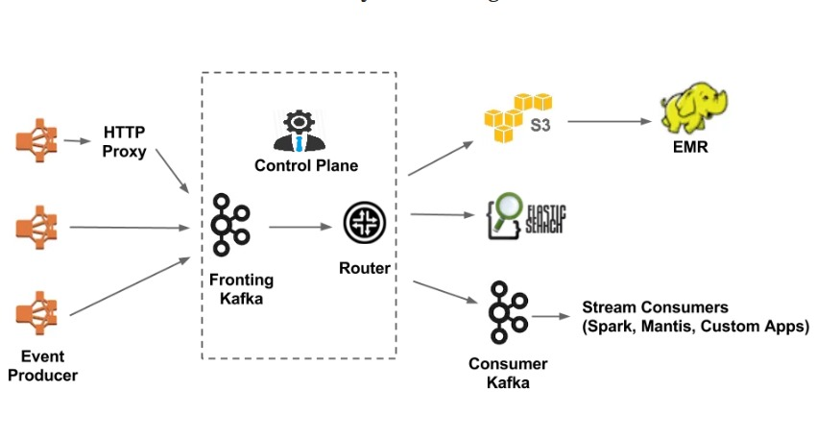
Netflix Real-Time Data Streaming Architecture

Slide 11
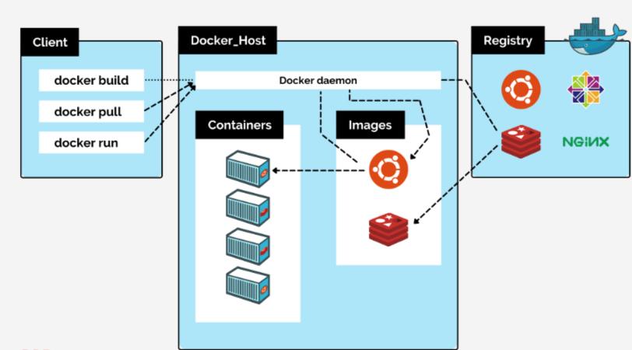
Docker – Containerization Platform
🔹 What is Docker? 💡 Think of Docker like a "shipping container" for apps. It lets developers package, deploy, and run applications consistently across different environments.
🔹 Why Use Docker? ✅ Portability
✅ Lightweight & Fast ✅ Scalability
✅ DevOps & CI/CD Integration
✅ Dependency Management
🔹 Best Use Cases ✔ Microservices Architecture
✔ CI/CD Pipelines ✔ Cloud-Native Applications
✔ Big Data & AI Workloads
✔ Cross-Platform Development

Slide 12
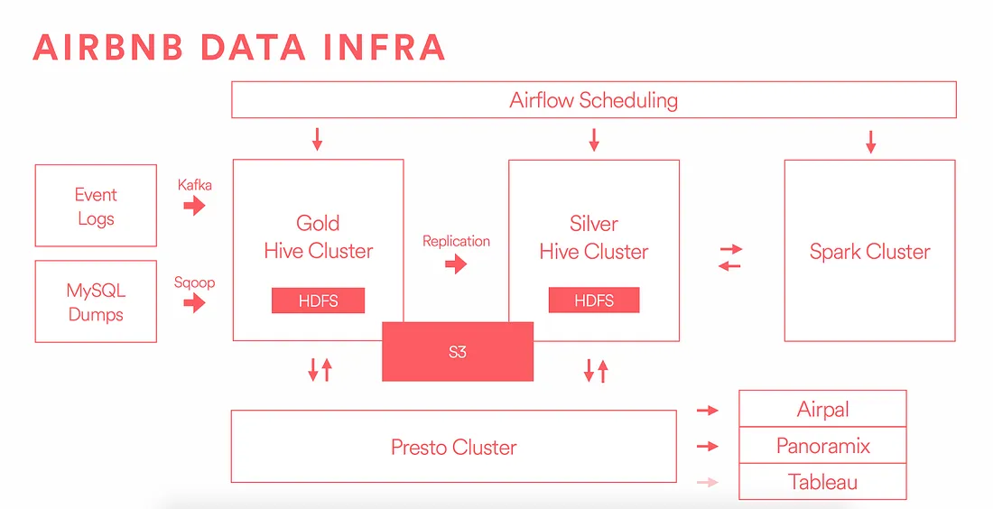
Airbnb Data Processing & Analytics Pipeline

Slide 13
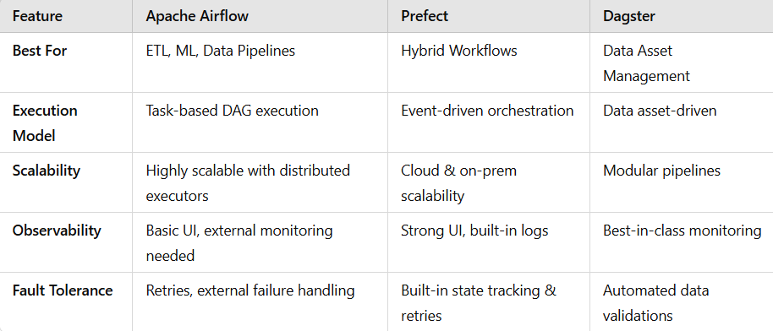
Orchestration Tools Comparison

Slide 14
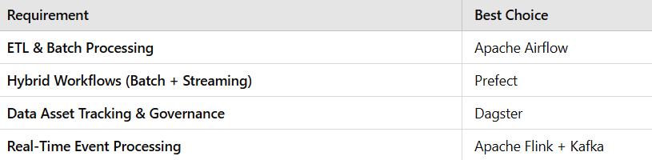
How to Choose the Right Orchestration Tool?
📌 Decision Framework for Selecting the Right Tool
✅ Checklist for Decision Making:
Do you need real-time data streaming? → Use Kafka or Flink
Do you need complex scheduling & task orchestration? → Use Airflow
Do you need data lineage tracking? → Use Dagster
Do you need cloud-friendly automation? → Use Prefect

Slide 15
Future Trends in Data Pipelines & Orchestration
AI-Driven
Automating pipeline optimizations using ML.
Serverless
Adoption of AWS Glue, Google Dataflow, Snowflake.
Hybrid/Multi-Cloud
Tools like Dagster & Prefect enable cross-cloud workflows.
Data Mesh
Rise of domain-driven data architectures.
Example-Enterprises use hybrid cloud pipelines for batch & streaming data across AWS, Azure, and GCP.

Slide 16
Conclusion – Why Data Pipelines & Orchestration Matter
Data Pipeline
Orchestration
Summarize
1. Data pipelines automate & scale data processing, making analytics and AI workflows more efficient.
2. Choosing batch vs. streaming pipelines depends on latency requirements & data volume.
1. Orchestration tools (Airflow, Prefect, Dagster) optimize workflow execution, improve reliability, and reduce errors.
2. Companies like Netflix, Uber, and Airbnb leverage hybrid models for better efficiency.
3. Future of orchestration is AI-driven automation, serverless architectures, and multi-cloud processing.
"Data pipelines are the backbone of modern data-driven businesses. Choosing the right approach & orchestration tool can transform how your organization handles data. Are you ready to optimize your workflows?"

Slide 17
Thanks!_
Do you have any questions?
Email Us. Will try to get back to you in 24 hrs.
talk2group5@group5.com
group5.com
Please keep this slide for attribution

